Slide 1
Predicting Wine Quality Through Machine Learning
ITSCM 778 Programming for Analytics (Capstone)
Ashley Pickett

Slide 2
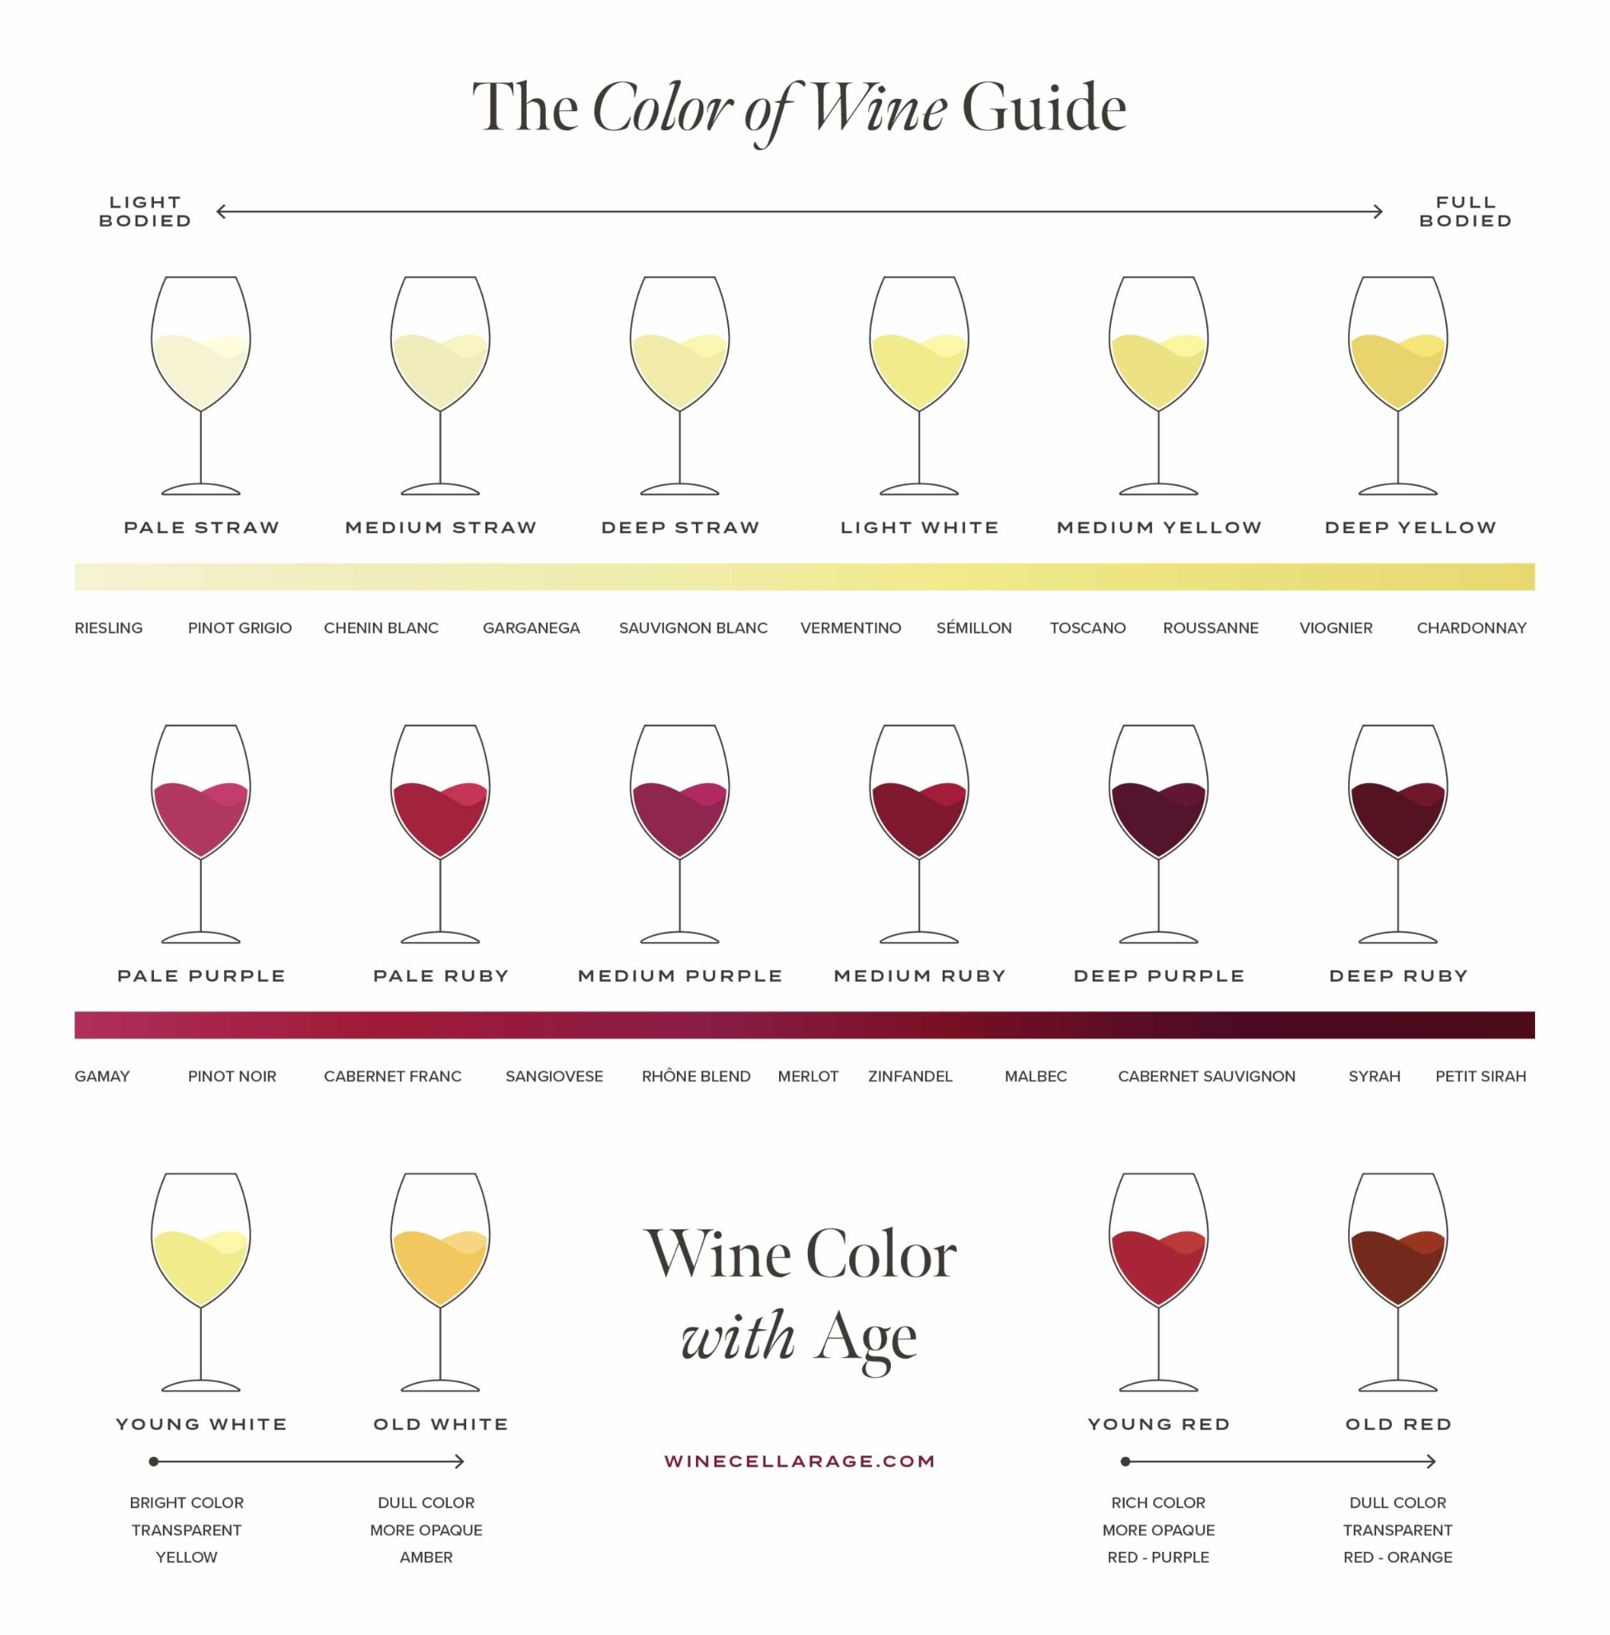
The Cost of Subjectivity in Wine Quality Assessment
Problem: Historically, wineries have relied on human expert tasters to determine the quality of a wine batch. This human-driven approach is inherently subjective, time-consuming, and expensive. It is difficult to scale and leaves room for inconsistency in quality control.
Solve: To solve this, the project uses machine learning algorithms to analyze the objective chemical properties of the wine (like alcohol content, acidity, and sugar). This creates a fast, cost-effective, and highly accurate automated system to predict wine quality, completely removing human bias from the equation.

Slide 3
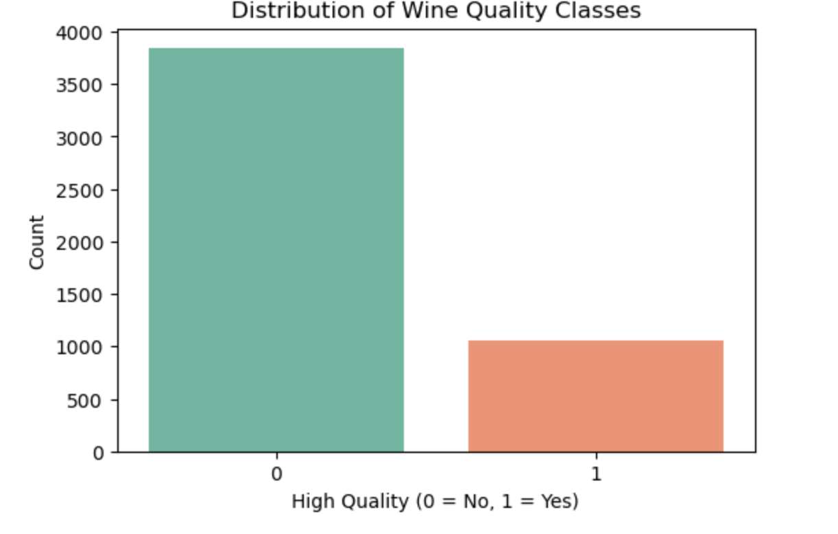
Exploring the Wine Quality Dataset
The X-Axis (Horizontal): This represents our target variable, High_quality. It is a binary classification, meaning there are only two possible categories.
0 represents "Standard Quality" (the baseline).
1 represents "High Quality" (the premium wines).
The Y-Axis (Vertical): This represents the "Count," which is the absolute number of individual wines in the dataset that fall into each category.
This is the most critical point to mention in your presentation. This chart visually proves that you have an imbalanced dataset.
In the real world, premium products are naturally rarer than standard products. This chart reflects reality truly excellent wine is harder to produce. The business goal isn't just to classify average wines; it is to accurately isolate that top 21.6% so the winery can price them accordingly and protect their premium brand reputation.
Bar Chart

Slide 4
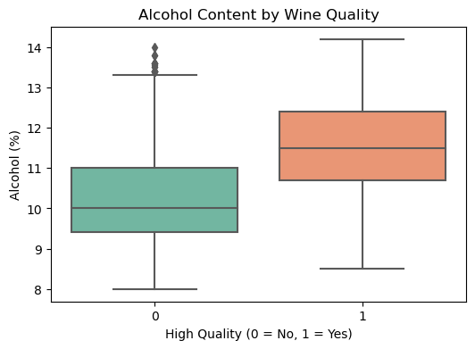
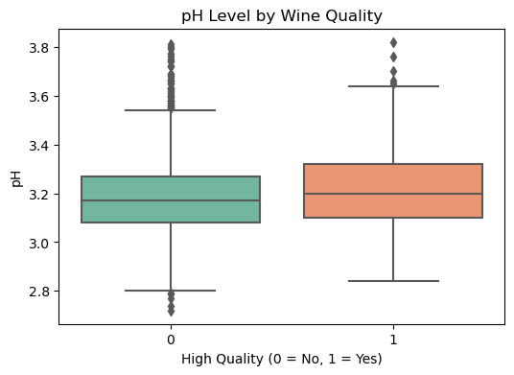
Exploring the Wine Quality Dataset
When you look at your Alcohol Content by Wine Quality box plot, you have two boxes side-by-side: one for Standard Quality (0) and one for High Quality (1).
You can visually see that the entire "box" (the middle 50%) for the High-Quality wines is shifted higher up the alcohol scale than the standard wines.
The median line for High-Quality wines is noticeably higher.
This visually proves to your audience that higher alcohol content is a consistent, reliable indicator of a premium wine, not just a random fluke.
Alcohol Content: Displays a strong positive relationship with high quality. The median and middle 50% of high-quality wines sit significantly higher.
pH Levels: Displays a neutral relationship. Acidity balance alone does not separate standard from premium wines.
Box Plot

Slide 5
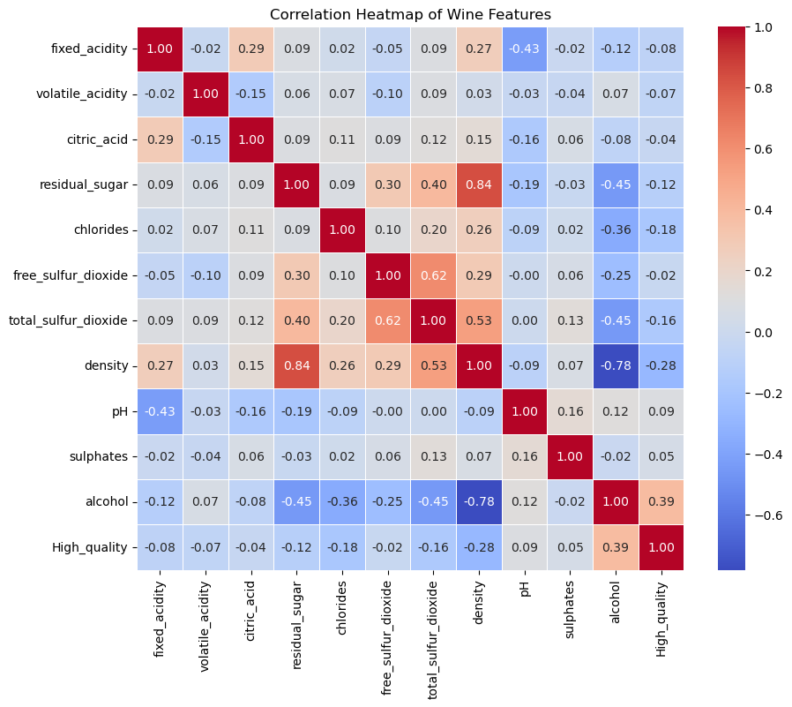
Exploring the Wine Quality Dataset
Heat Map linear relationships across all 11 chemical features and our target variable.
Alcohol shows the strongest positive correlation (+0.38) with High Quality.
Found a strong negative correlation (-0.78) between Density and Alcohol.
Selected a Random Forest Classifier specifically because decision-tree models handle collinear features better than standard regression models.
Heat Map

Slide 6
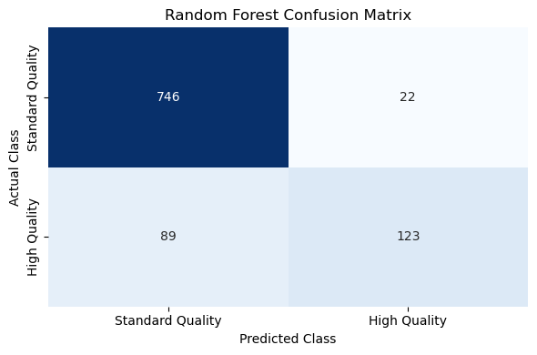
Exploring the Wine Quality Dataset
Top-Left (True Negatives): The model predicted the wine was "Standard Quality" (0), and it actually was. This is a correct prediction.
Bottom-Right (True Positives): The model predicted the wine was "High Quality" (1), and it actually was. This is a correct prediction.
Top-Right (False Positives) - Type I Error): The model predicted the wine was "High Quality", but it was actually just a standard wine. The model overestimated the wine.
Bottom-Left (False Negatives - Type II Error): The model predicted the wine was "Standard Quality", but it was actually a premium, high-quality wine. The model missed a good wine.
Why: ability to handle non-linear relationships and multicollinearity
Random Forest Classification

Slide 7
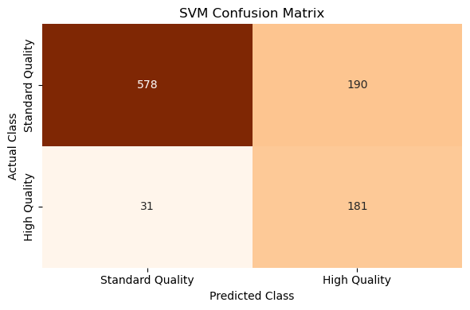
Exploring the Wine Quality Dataset
To ensuring distance-based calculations were accurate. Grid Search used to tune regularization and kernel parameters.
To provide a mathematical contrast to the tree-based Random Forest model, evaluating if a clear geometric boundary exists between quality classes.
Specifically wanted to evaluate the Accuracy, Precision, and Recall. Support the fact the focus remained on the F1-Score for the minority "High Quality" class to determine the ultimate champion model
Why: To evaluate if a clear mathematical boundary exists between classes after feature scaling
SVM Confusion Matrix

Slide 8
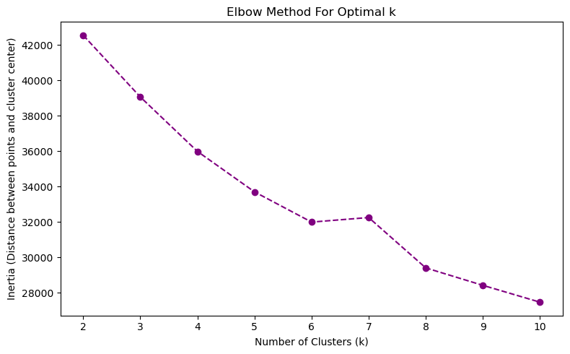
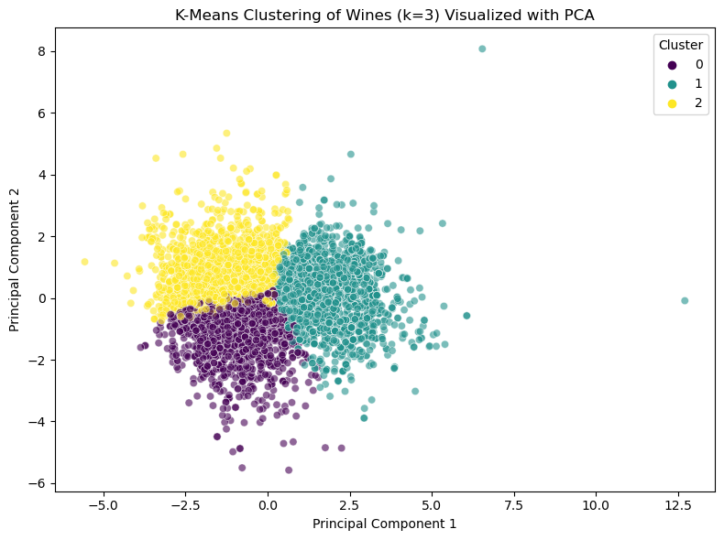
Exploring the Wine Quality Dataset
The unsupervised learning phase, I utilized K-Means clustering to identify natural groupings within our wine inventory based solely on their chemical fingerprints
To determine the optimal number of clusters, I utilized the Elbow Method then observed a significant bend at k=3, indicating that three distinct groups provided the most meaningful separation.
I found three distinct market segments: a group of high-alcohol dry wines, a group of lighter sweet wines, and a group of balanced high-acidity wines.
This is invaluable. Instead of relying on a human to manually sort thousands of bottles, the winery can now use these profiles to automatically direct different batches to the appropriate marketing channels or price points based on the chemical preferences of their customers
K Means Clustering

Slide 9
Conclusion & Recommendations
Model Champion: The Random Forest Classifier and SVM is the recommended solution due to its superior F1-Score, successfully identifying high-quality wines despite the significant class imbalance.
Operational Efficiency: Implementing this automated chemical screening reduces reliance on subjective tasting panels, accelerating the "time-to-market" for new batches.
Market Advantage: The K-Means clustering profiles provide a data-driven roadmap for targeted marketing, allowing for precise segmentation of "Dry" vs. "Sweet" consumer preferences.
Future Scalability: This framework can be integrated into a real-time monitoring dashboard, allowing winemakers to adjust fermentation variables mid-process to maximize the probability of a "High Quality" output.
Brand Consistency while ensuring every 'High Quality' bottle actually meets the chemical standard and Cost Reduction less reliance on expensive tasting panels.

